Slide 1
CS162 Operating Systems and Systems Programming Lecture 6 Concurrency (Continued), Synchronization (Start)
February 8th, 2016
Prof. John Kubiatowicz
http://cs162.eecs.Berkeley.edu

Slide 2
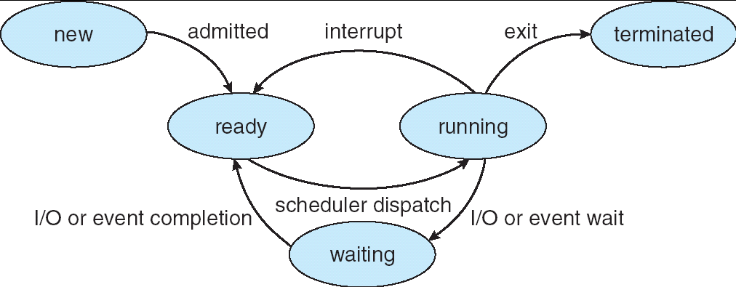
Recall: Lifecycle of a Process
As a process executes, it changes state:
new: The process is being created
ready: The process is waiting to run
running: Instructions are being executed
waiting: Process waiting for some event to occur
terminated: The process has finished execution

Slide 3
Recall: Use of Threads
Version of program with Threads (loose syntax):
main() {
ThreadFork(ComputePI(“pi.txt”));
ThreadFork(PrintClassList(“classlist.txt”));
}
What does “ThreadFork()” do?
Start independent thread running given procedure
What is the behavior here?
Now, you would actually see the class list
This should behave as if there are two separate CPUs
CPU1
CPU2
CPU1
CPU2
CPU1
CPU2
Time

Slide 4
Recall: Multithreaded stack switching
Consider the following code blocks:
proc A() {
B();
}
proc B() {
while(TRUE) {
yield();
}
}
Suppose we have 2 threads:
Threads S and T
Thread S
Thread T
A
A
B(while)
B(while)
Stack growth
yield
yield
run_new_thread
run_new_thread
switch
switch

Slide 5
Recall: Use of Timer Interrupt to Return Control
Solution to our dispatcher problem
Use the timer interrupt to force scheduling decisions
Timer Interrupt routine: TimerInterrupt() { DoPeriodicHouseKeeping(); run_new_thread(); }
Some Routine
Interrupt
TimerInterrupt
Stack growth
run_new_thread
switch

Slide 6
Per Thread Descriptor (Kernel Supported Threads)
Each Thread has a Thread Control Block (TCB)
Execution State: CPU registers, program counter (PC), pointer to stack (SP)
Scheduling info: state, priority, CPU time
Various Pointers (for implementing scheduling queues)
Pointer to enclosing process (PCB) – user threads
Etc (add stuff as you find a need)
OS Keeps track of TCBs in “kernel memory”
In Array, or Linked List, or …
I/O state (file descriptors, network connections, etc)

Slide 7
ThreadFork(): Create a New Thread
ThreadFork() is a user-level procedure that creates a new thread and places it on ready queue
We called this CreateThread() earlier
Arguments to ThreadFork()
Pointer to application routine (fcnPtr)
Pointer to array of arguments (fcnArgPtr)
Size of stack to allocate
Implementation
Sanity Check arguments
Enter Kernel-mode and Sanity Check arguments again
Allocate new Stack and TCB
Initialize TCB and place on ready list (Runnable)

Slide 8
How do we initialize TCB and Stack?
Initialize Register fields of TCB
Stack pointer made to point at stack
PC return address ⇒ OS (asm) routine ThreadRoot()
Two arg registers (a0 and a1) initialized to fcnPtr and fcnArgPtr, respectively
Initialize stack data?
No. Important part of stack frame is in registers (ra)
Think of stack frame as just before body of ThreadRoot() really gets started
ThreadRoot stub
Stack growth
Initial Stack

Slide 9
How does Thread get started?
Other Thread
ThreadRoot
A
B(while)
Stack growth
yield
run_new_thread
New Thread
switch
ThreadRoot stub
Eventually, run_new_thread() will select this TCB and return into beginning of ThreadRoot()
This really starts the new thread

Slide 10
What does ThreadRoot() look like?
ThreadRoot() is the root for the thread routine:
ThreadRoot() {
DoStartupHousekeeping();
UserModeSwitch(); /* enter user mode */
Call fcnPtr(fcnArgPtr);
ThreadFinish();
}
Startup Housekeeping
Includes things like recording start time of thread
Other Statistics
Stack will grow and shrink with execution of thread
Final return from thread returns into ThreadRoot() which calls ThreadFinish()
ThreadFinish() wake up sleeping threads
ThreadRoot
Thread Code
Stack growth
Running Stack

Slide 11
Famous Quote wrt Scheduling: Dennis Richie
Dennis Richie, Unix V6, slp.c:
“If the new process paused because it was swapped out, set the stack level to the last call to savu(u_ssav). This means that the return which is executed immediately after the call to aretu actually returns from the last routine which did the savu.”
“You are not expected to understand this.”
Source: Dennis Ritchie, Unix V6 slp.c (context-switching code) as per The Unix Heritage Society(tuhs.org); gif by Eddie Koehler.
Included by Ali R. Butt in CS3204 from Virginia Tech

Slide 12
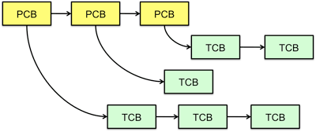
Multithreaded Processes
Process Control Block (PCBs) points to multiple Thread Control Blocks (TCBs):
Switching threads within a block is a simple thread switch
Switching threads across blocks requires changes to memory and I/O address tables

Slide 13
Administrivia
TA selection form
Due tonight by midnight tonight !
We will try to do final section assignment tomorrow
Your section is your home for CS162
The TA needs to get to know you to judge participation
All design reviews will be conducted by your TA
You can attend alternate section by same TA, but try to keep the amount of such cross-section movement to a minimum
Project #1: Starts today!
HW1 due next Monday
Submit via git

Slide 14
Examples multithreaded programs
Embedded systems
Elevators, Planes, Medical systems, Wristwatches
Single Program, concurrent operations
Most modern OS kernels
Internally concurrent because have to deal with concurrent requests by multiple users
But no protection needed within kernel
Database Servers
Access to shared data by many concurrent users
Also background utility processing must be done
Notes:
DB servers very important – provide “shared data” view to users.
Many users can read/write at once – how is consistency managed?

Slide 15
Example multithreaded programs (con’t)
Network Servers
Concurrent requests from network
Again, single program, multiple concurrent operations
File server, Web server, and airline reservation systems
Parallel Programming (More than one physical CPU)
Split program into multiple threads for parallelism
This is called Multiprocessing
Some multiprocessors are actually uniprogrammed:
Multiple threads in one address space but one program at a time

Slide 16
A Typical Use Case
Client Browser
- process for each tab
- thread to render page
- GET in separate thread
- multiple outstanding GETs
- as they complete, render
portion
Web Server
- fork process for each client connection
- thread to get request and issue response
- fork threads to read data, access DB, etc
- join and respond

Slide 17
Kernel Use Cases
Thread for each user process
Thread for sequence of steps in processing I/O
Threads for device drivers
…

Slide 18
Putting it Together: Process
(Unix) Process
A(int tmp) {
if (tmp<2)
B();
printf(tmp);
}
B() {
C();
}
C() {
A(2);
}
A(1);
…
Memory
Stack
Resources
I/O State
(e.g., file, socket contexts)
Sequential stream of instructions
CPU state (PC, SP, registers..)
Stored in OS

Slide 19
Putting it Together: Processes
Process 1
Process 2
Process N
Switch overhead: high
Kernel entry: low (ish)
CPU state: low
Memory/IO state: high
Process creation: high
Protection
CPU: yes
Memory/IO: yes
Sharing overhead: high (involves at least a context switch)
Mem.
Mem.
Mem.
IO
state
IO
state
…
IO
state
CPU
state
CPU
state
CPU
state
CPU sched.
OS
1 process at a time
CPU
(1 core)

Slide 20
Putting it Together: Threads
Process 1
Process N
threads
threads
Switch overhead: medium
Kernel entry: low(ish)
CPU state: low
Thread creation: medium
Protection
CPU: yes
Memory/IO: No
Sharing overhead: low(ish) (thread switch overhead low)
Mem.
Mem.
…
IO
state
…
…
IO
state
CPU
state
CPU
state
CPU
state
CPU
state
CPU sched.
OS
1 thread at a time
CPU
(1 core)

Slide 21
Kernel versus User-Mode Threads
We have been talking about Kernel threads
Native threads supported directly by the kernel
Every thread can run or block independently
One process may have several threads waiting on different things
Downside of kernel threads: a bit expensive
Need to make a crossing into kernel mode to schedule
Lighter weight option: User Threads

Slide 22
User-Mode Threads
Lighter weight option:
User program provides scheduler and thread package
May have several user threads per kernel thread
User threads may be scheduled non-premptively relative to each other (only switch on yield())
Cheap
Downside of user threads:
When one thread blocks on I/O, all threads block
Kernel cannot adjust scheduling among all threads
Option: Scheduler Activations
Have kernel inform user level when thread blocks…

Slide 23
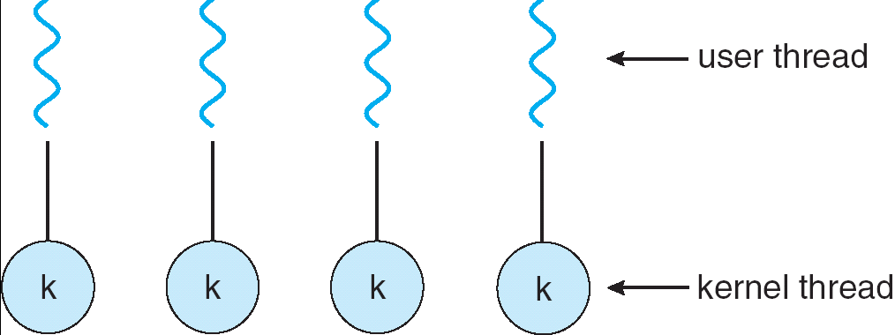
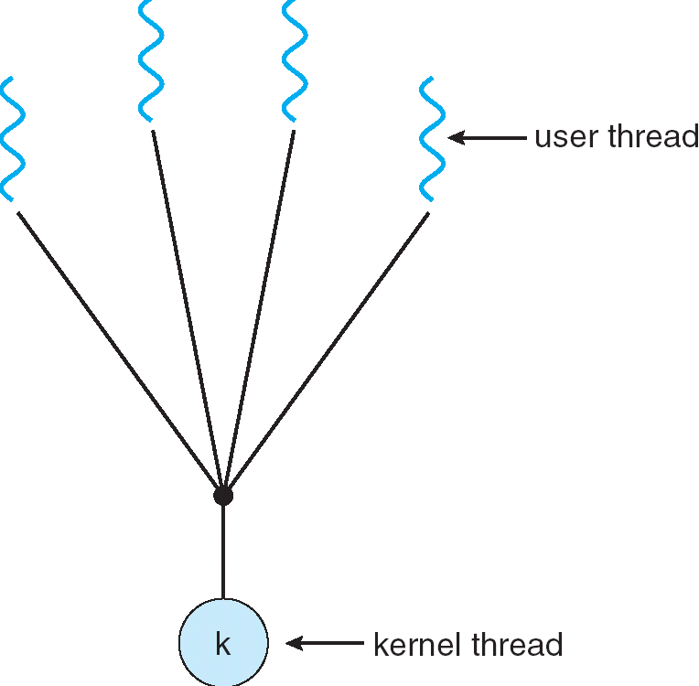
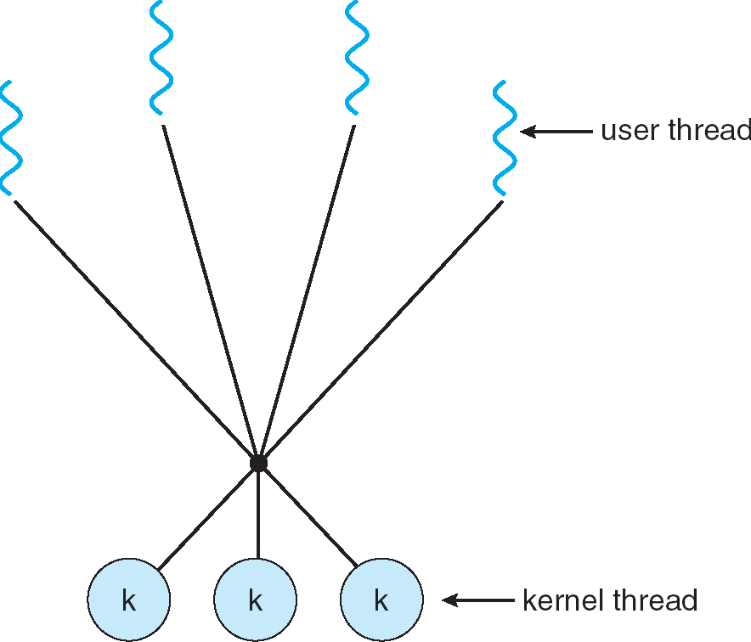
Some Threading Models
Simple One-to-One
Threading Model
Many-to-One
Many-to-Many

Slide 24
Threads in a Process
Threads are useful at user-level: Parallelism, hide I/O latency, interactivity
Option A (early Java): user-level library, within a single-threaded process
Library does thread context switch
Kernel time slices between processes, e.g., on system call I/O
Option B (SunOS, Linux/Unix variants): green Threads
User-level library does thread multiplexing
Option C (Windows): scheduler activations
Kernel allocates processors to user-level library
Thread library implements context switch
System call I/O that blocks triggers upcall
Option D (Linux, MacOS, Windows): use kernel threads
System calls for thread fork, join, exit (and lock, unlock,…)
Kernel does context switching
Simple, but a lot of transitions between user and kernel mode

Slide 25
Putting it Together: Multi-Cores
Process 1
Process N
threads
threads
Switch overhead: low (only CPU state)
Thread creation: low
Protection
CPU: yes
Memory/IO: No
Sharing overhead: low (thread switch overhead low, may not need to switch at all!)
Mem.
Mem.
…
IO
state
…
…
IO
state
CPU
state
CPU
state
CPU
state
CPU
state
CPU sched.
OS
4 threads at a time
Core 1
Core 2
Core 3
Core 4
CPU

Slide 26
Putting it Together: Hyper-Threading
Process 1
Process N
threads
threads
Switch overhead between hardware-threads: very-low (done in hardware)
Contention for ALUs/FPUs may hurt performance
Mem.
Mem.
…
IO
state
…
…
IO
state
CPU
state
CPU
state
CPU
state
CPU
state
CPU sched.
OS
hardware-threads
(hyperthreading)
8 threads at a time
Core 1
Core 2
Core 3
Core 4
CPU

Slide 27
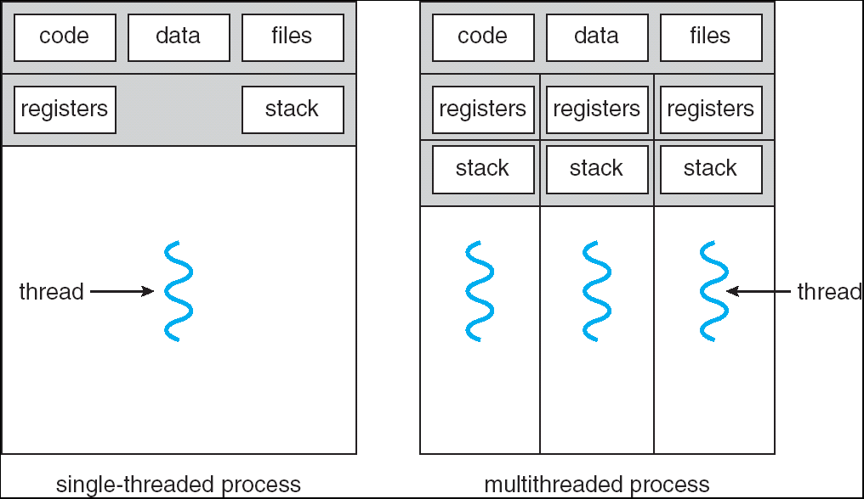
Supporting 1T and MT Processes
User
***
System
Notes:
Sometimes need parallelism for a single job, and processes are very expensive – to start, switch between, and to communicate between

Slide 28
Supporting 1T and MT Processes
User
***
***
System
Notes:
Sometimes need parallelism for a single job, and processes are very expensive – to start, switch between, and to communicate between

Slide 29
Classification
One
Many
# of addr spaces:
# threads
Per AS:
One
MS/DOS, early Macintosh
Traditional UNIX
Many
Embedded systems (Geoworks, VxWorks, JavaOS,etc)
JavaOS, Pilot(PC)
Mach, OS/2, Linux
Windows 9x???
Win NT to XP, Solaris, HP-UX, OS X
Real operating systems have either
One or many address spaces
One or many threads per address space
Did Windows 95/98/ME have real memory protection?
No: Users could overwrite process tables/System DLLs

Slide 30
Break

Slide 31
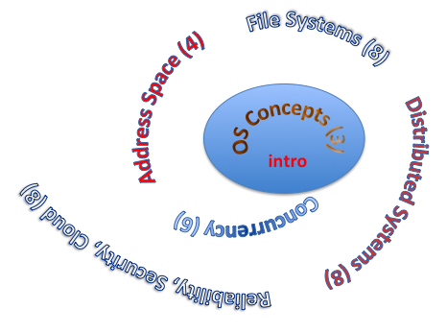
You are here… why?
Processes
Thread(s) + address space
Address Space
Protection
Dual Mode
Interrupt handlers
Interrupts, exceptions, syscall
File System
Integrates processes, users, cwd, protection
Key Layers: OS Lib, Syscall, Subsystem, Driver
User handler on OS descriptors
Process control
fork, wait, signal, exec
Communication through sockets
Integrates processes, protection, file ops, concurrency
Client-Server Protocol
Concurrent Execution: Threads
Scheduling

Slide 32
Perspective on ‘groking’ 162
Historically, OS was the most complex software
Concurrency, synchronization, processes, devices, communication, …
Core systems concepts developed there
Today, many “applications” are complex software systems too
These concepts appear there
But they are realized out of the capabilities provided by the operating system
Seek to understand how these capabilities are implemented upon the basic hardware
See concepts multiple times from multiple perspectives
Lecture provides conceptual framework, integration, examples, …
Book provides a reference with some additional detail
Lots of other resources that you need to learn to use
man pages, google, reference manuals, includes (.h)
Section, Homework and Project provides detail down to the actual code AND direct hands-on experience

Slide 33
Operating System as Design
Word Processing
Compilers
Web Browsers
Email
Databases
Web Servers
Application / Service
Portable OS Library
OS
User
System Call
Interface
System
Portable OS Kernel
Software
Platform support, Device Drivers
Hardware
x86
PowerPC
ARM
PCI
802.11 a/b/g/n
Graphics
Ethernet (10/100/1000)
SCSI
IDE

Slide 34
Starting today: PintOS Projects
Process 1
Process 2
Process N
Groups almost all formed
Work as one!
10x homework
P1: threads & scheduler
P2: user process
P3: file system
Mem
Mem
Mem
IO
state
IO
state
…
IO
state
CPU
state
CPU
state
CPU
state
CPU sched.
PintOS
CPU
(emulated)

Slide 35
MT Kernel 1T Process ala Pintos/x86
code
data
magic #
list
Kernel
priority
stack
status
User
tid
code
code
data
data
heap
***
heap
User
stack
User
stack
Each user process/thread associated with a kernel thread, described by a 4kb Page object containing TCB and kernel stack for the kernel thread

Slide 36
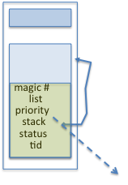
In User thread, w/ k-thread waiting
code
data
magic #
list
Kernel
priority
stack
status
User
tid
code
code
data
data
heap
***
heap
IP
User
stack
User
stack
SP
K SP
Proc Regs
PL: 3
x86 proc holds interrupt SP high system level
During user thread exec, associate kernel thread is “standing by”

Slide 37
In Kernel thread
code
data
magic #
list
Kernel
priority
stack
status
User
tid
code
code
data
data
heap
***
heap
IP
User
stack
User
stack
SP
K SP
Proc Regs
PL: 0
Kernel threads execute with small stack in thread struct
Scheduler selects among ready kernel and user threads

Slide 38
Thread Switch (switch.S)
code
data
magic #
list
Kernel
priority
stack
status
User
tid
code
code
data
data
heap
***
heap
IP
User
stack
User
stack
SP
K SP
Proc Regs
PL: 0
switch_threads: save regs on current small stack, change SP, return from destination threads call to switch_threads

Slide 39
Switch to Kernel Thread for Process
code
data
magic #
list
Kernel
priority
stack
status
User
tid
code
code
data
data
heap
***
heap
IP
User
stack
User
stack
SP
K SP
Proc Regs
PL: 0

Slide 40
Kernel->User
code
data
magic #
list
Kernel
priority
stack
status
User
tid
code
code
data
data
heap
***
heap
IP
User
stack
User
stack
SP
K SP
Proc Regs
PL: 3
iret restores user stack and PL

Slide 41
User->Kernel
code
data
magic #
list
Kernel
priority
stack
status
User
tid
code
code
data
data
heap
***
heap
IP
User
stack
User
stack
SP
K SP
Proc Regs
PL: 0
Mechanism to resume k-thread goes through interrupt vector

Slide 42
User->Kernel via interrupt vector
code
0
data
Kernel
User
code
code
255
intr vector
data
data
heap
***
heap
IP
User
stack
User
stack
SP
K SP
Proc Regs
PL: 3
Interrupt transfers control through the IV (IDT in x86)
iret restores user stack and PL

Slide 43
Pintos Interrupt Processing
stubs
Wrapper for generic handler
***
0
intr_entry:
save regs as frame
set up kernel env.
call intr_handler
intr_exit:
restore regs
iret
push 0x20 (int #)
jmp intr_entry
0x20
push 0x21 (int #)
jmp intr_entry
***
255
Hardware interrupt vector
stubs.S

Slide 44
Recall: cs61C THE STACK FRAME

Slide 45
Pintos Interrupt Processing
interrupt.c
Wrapper for generic handler
Intr_handler(*frame)
- classify
- dispatch
- ack IRQ
- maybe thread yield
stubs
0
***
intr_entry:
save regs as frame
set up kernel env.
call intr_handler
intr_exit:
restore regs
iret
push 0x20 (int #)
jmp intr_entry
0x20
push 0x21 (int #)
jmp intr_entry
timer_intr(*frame)
tick++
thread_tick()
0
***
255
0x20
timer.c
Hardware interrupt vector
stubs.S
Pintos intr_handlers

Slide 46
Timer may trigger thread switch
thread_tick
Updates thread counters
If quanta exhausted, sets yield flag
thread_yield
On path to rtn from interrupt
Sets current thread back to READY
Pushes it back on ready_list
Calls schedule to select next thread to run upon iret
Schedule
Selects next thread to run
Calls switch_threads to change regs to point to stack for thread to resume
Sets its status to RUNNING
If user thread, activates the process
Returns back to intr_handler

Slide 47
Pintos Return from Processing
interrupt.c
Wrapper for generic handler
Intr_handler(*frame)
- classify
- dispatch
- ack IRQ
- maybe thread yield
stubs
0
***
intr_entry:
save regs as frame
set up kernel env.
call intr_handler
intr_exit:
restore regs
iret
push 0x20 (int #)
jmp intr_entry
0x20
push 0x20 (int #)
jmp intr_entry
timer_intr(*frame)
tick++
thread_tick()
0
***
255
0x20
timer.c
Hardware interrupt vector
Hardware interrupt vector
stubs.S
thread_yield()
- schedule
Resume Some Thread
Pintos intr_handlers
schedule()
- switch

Slide 48
Recall: Thread Abstraction
Infinite number of processors
Threads execute with variable speed
Programs must be designed to work with any schedule
Notes:
Execution model: each thread runs on a dedicated virtual processor with unpredictable and variable speed.

Slide 49
Multiprocessing vs Multiprogramming
Remember Definitions:
Multiprocessing ≡ Multiple CPUs
Multiprogramming ≡ Multiple Jobs or Processes
Multithreading ≡ Multiple threads per Process
What does it mean to run two threads “concurrently”?
Scheduler is free to run threads in any order and interleaving: FIFO, Random, …
Dispatcher can choose to run each thread to completion or time-slice in big chunks or small chunks
A
Multiprocessing
B
C
A
B
C
Multiprogramming
A
B
C
A
B
C
B

Slide 50
Correctness for systems with concurrent threads
If dispatcher can schedule threads in any way, programs must work under all circumstances
Can you test for this?
How can you know if your program works?
Independent Threads:
No state shared with other threads
Deterministic ⇒ Input state determines results
Reproducible ⇒ Can recreate Starting Conditions, I/O
Scheduling order doesn’t matter (if switch() works!!!)
Cooperating Threads:
Shared State between multiple threads
Non-deterministic
Non-reproducible
Non-deterministic and Non-reproducible means that bugs can be intermittent
Sometimes called “Heisenbugs”

Slide 51
Interactions Complicate Debugging
Is any program truly independent?
Every process shares the file system, OS resources, network, etc
Extreme example: buggy device driver causes thread A to crash “independent thread” B
You probably don’t realize how much you depend on reproducibility:
Example: Evil C compiler
Modifies files behind your back by inserting errors into C program unless you insert debugging code
Example: Debugging statements can overrun stack
Non-deterministic errors are really difficult to find
Example: Memory layout of kernel+user programs
depends on scheduling, which depends on timer/other things
Original UNIX had a bunch of non-deterministic errors
Example: Something which does interesting I/O
User typing of letters used to help generate secure keys
Notes:
Adding printf statements can cause stack overruns or changing timing/interleaving
What if non-deterministic error only occurs once a week? You’re pulling all-nighters to find it, your eyelids droop, and whiz, the error happens and you missed it.

Slide 52
Why allow cooperating threads?
People cooperate; computers help/enhance people’s lives, so computers must cooperate
By analogy, the non-reproducibility/non-determinism of people is a notable problem for “carefully laid plans”
Advantage 1: Share resources
One computer, many users
One bank balance, many ATMs
What if ATMs were only updated at night?
Embedded systems (robot control: coordinate arm & hand)
Advantage 2: Speedup
Overlap I/O and computation
Many different file systems do read-ahead
Multiprocessors – chop up program into parallel pieces
Advantage 3: Modularity
More important than you might think
Chop large problem up into simpler pieces
To compile, for instance, gcc calls cpp | cc1 | cc2 | as | ld
Makes system easier to extend

Slide 53
Summary (1 of 2)
Processes have two parts
Threads (Concurrency)
Address Spaces (Protection)
Concurrency accomplished by multiplexing CPU Time:
Unloading current thread (PC, registers)
Loading new thread (PC, registers)
Such context switching may be voluntary (yield(), I/O operations) or involuntary (timer, other interrupts)
Protection accomplished restricting access:
Memory mapping isolates processes from each other
Dual-mode for isolating I/O, other resources
Various Textbooks talk about processes
When this concerns concurrency, really talking about thread portion of a process
When this concerns protection, talking about address space portion of a process

Slide 54
Summary (2 or 2)
Concurrent threads are a very useful abstraction
Allow transparent overlapping of computation and I/O
Allow use of parallel processing when available
Concurrent threads introduce problems when accessing shared data
Programs must be insensitive to arbitrary interleavings
Without careful design, shared variables can become completely inconsistent
Important concept: Atomic Operations
An operation that runs to completion or not at all
These are the primitives on which to construct various synchronization primitives
Showed how to protect a critical section with only atomic load and store ⇒ pretty complex!

